Slide 1
C# Object Oriented Programming

Slide 2
Four pillars of Object Oriented Programming
Encapsulation
Avoid directly access to data (data hiding)
Inheritance
Reusing and adding new abilities
Polymorphism
Objects with different types can be accessed through the same interface
Abstraction
What – not how

Slide 3
Core concepts
Class & Object, UML Class diagram
Override & Overloading
Abstract class
Interface

Slide 4
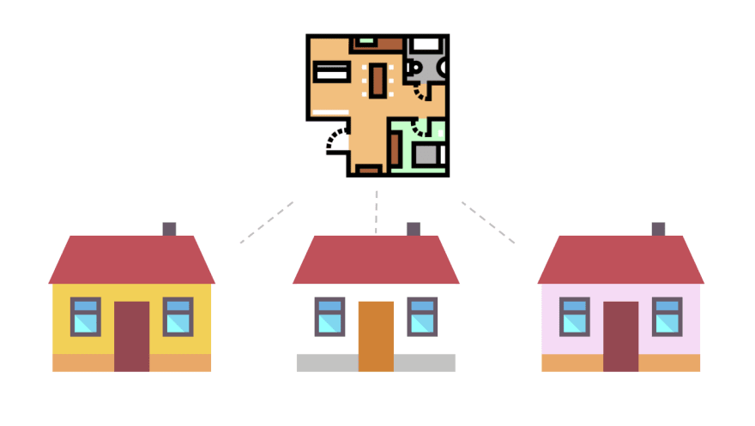
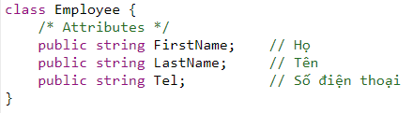
Class
A blueprint to create objects
Class House
House 1
House 2
House 3

Slide 5
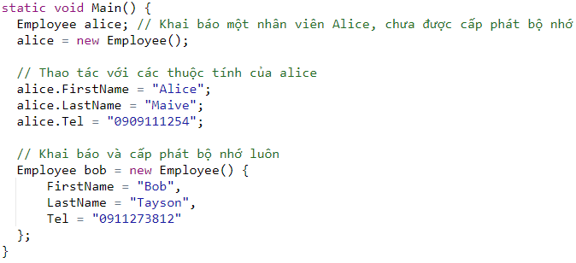
Object
A specific instance created from a class
How many classes are there? How many instances are there?

Slide 6

Common misunderstanding & error for beginners

Slide 7
Destructor
No need because we have an automatic Garbage Collector

Slide 8

What does a class have?
Attributes (data)
Behaviors (functions)
Attributes: weight, height
Behaviors: eat, sleep, run
When a cat eats, what changes?
When a cat sleep, what changes?

Slide 9

Behaviors can change attributes
eat
sleep

Slide 10
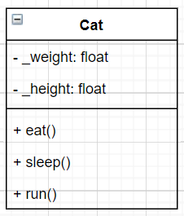
Represent a cat with UML
Universal Modeling Language
Attributes
Behaviors

Slide 11
Note
Class is a blueprint of object
Object is an instance of a class
A class has attributes & behaviors
Behaviors can change an object’s attributes
Use UML to model a class
Abstraction: focus on what is important

Slide 12
In-class exercise
Create UML diagram using draw.io (or your favourite) for
1. A soldier that has Hit points and Mana, can attack and defend
2. An Autobot transformer that can toggle between vehicle form and robot form, fly, fight and escape. Its life depends on its energy in W
Submit back the image in this format: StudentID.png/jpg

Slide 13
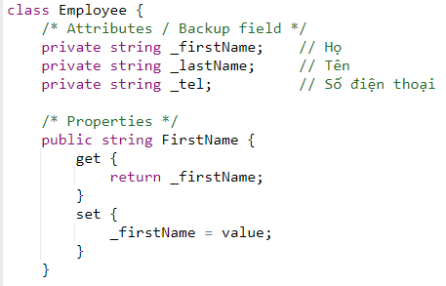
Encapsulation - Getter & Setter
Avoid direct access to attribute

Slide 14
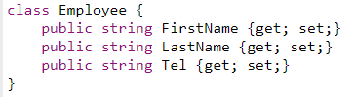
Shortcut for encapsulation

Slide 15
Why should we use getter & setter?
May be adding business logic later
For example: your account has a balce of 20.000, you cannot withdraw 30.000
Isolation, good for maintenance
UI programming: databinding!
UI elements automatically update based on the databound variable

Slide 16
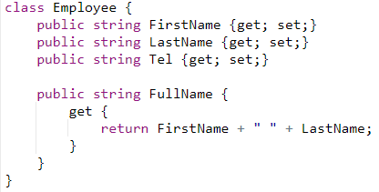
Derivative property

Slide 17
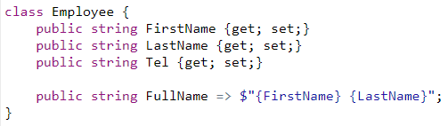
Lambda expression

Slide 18
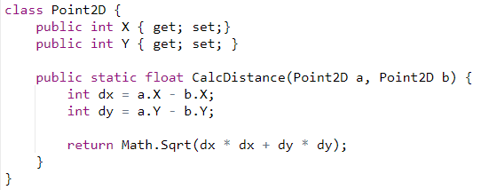
Static function

Slide 19
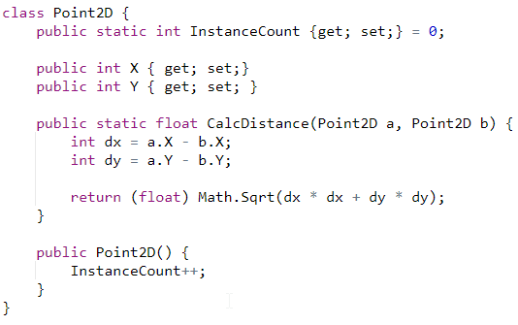
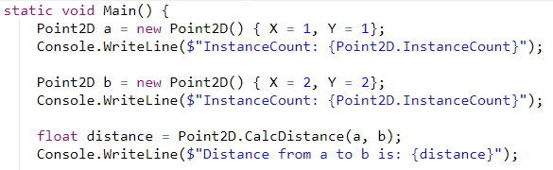
Static attribute

Slide 20
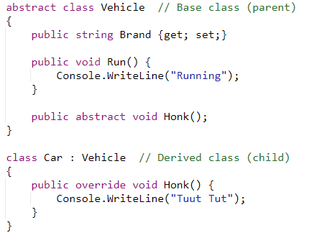
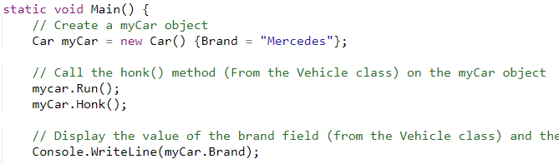
Inheritance

Slide 21
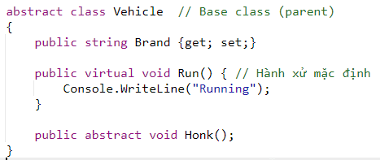
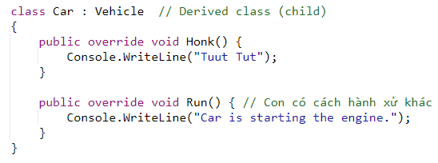
Overriding

Slide 22
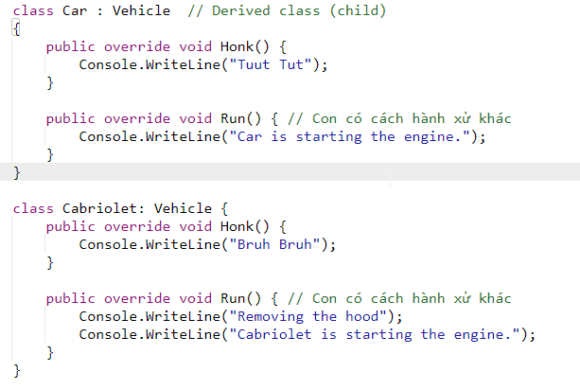
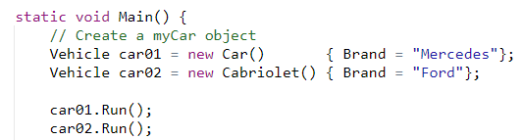
Polymorphism

Slide 23
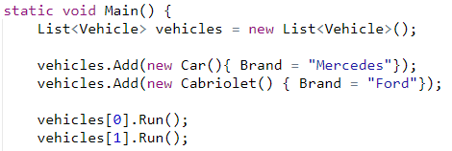
Array of objects

Slide 24
Multiple inheritance
C# does not support multiple classes inheritance
But we have multiple interfaces inheritance

Slide 25
In-class exercise
A student will have this information: StudentID, FullName, GPA, Address, Telephone number.
Generate random 10 students
Print out the average GPA of all the students
Print out the name of top 3 students with highest GPA

Slide 26
References
https://www.w3schools.com/cs/cs_oop.asp

Slide 27
Homework

